Slide 1
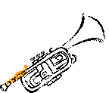
The Seven Trumpets
Wallace, Steven J. www.revelationandcreation.com
Revelation 8:7 – 11:19

Slide 2
Seals To Trumpets
Seal 1
Seal 2
Seal 3
Seal 4
Seal 5
Seal 6
Seal 7
  Trumpets 1-7
Seals: Revelation
Trumpets: Warning
Joshua 6:4, 5; Ezek. 33:1-6

Slide 3
Prepare to Sound (8:6)
Seven angels prepare (v. 6)
  1-4 trumpets afflict men indirectly by nature
    Note: natural calamities ought to remind us that we really do not control the world
  5, 6 trumpets afflict mankind directly
  7 is the defeat of the wicked kingdoms by the Lord

Slide 4
Reasons For Rome’s Fall
natural disasters
internal rottenness
invasions
THE REAL REASON:
THEIR OPPOSITION TO THE LAMB OF GOD
  Compare Acts 5:33-42

Slide 5
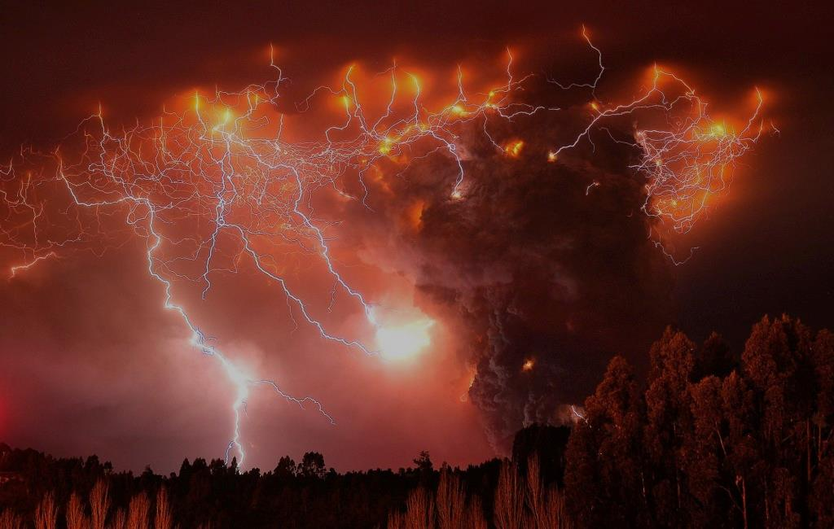
First Trumpet (8:7)
Hail & Fire
  instruments of judgment
  fire is probably lightening
  first trumpet symbolically follows the seventh plague in Egypt (Ex. 9:22-28; Ps. 78:47-49)
Mingled with blood –loss of life

Slide 6
First Trumpet (8:7)
1/3rd of trees and all grass burned
  fractions indicate limited judgment
  added intensity from the fourth horseman (6:8)
  trees as possible rulers, domain (Dan. 4:20-22)
  grass as possible commoner (Is. 40:6, 7)

Slide 7
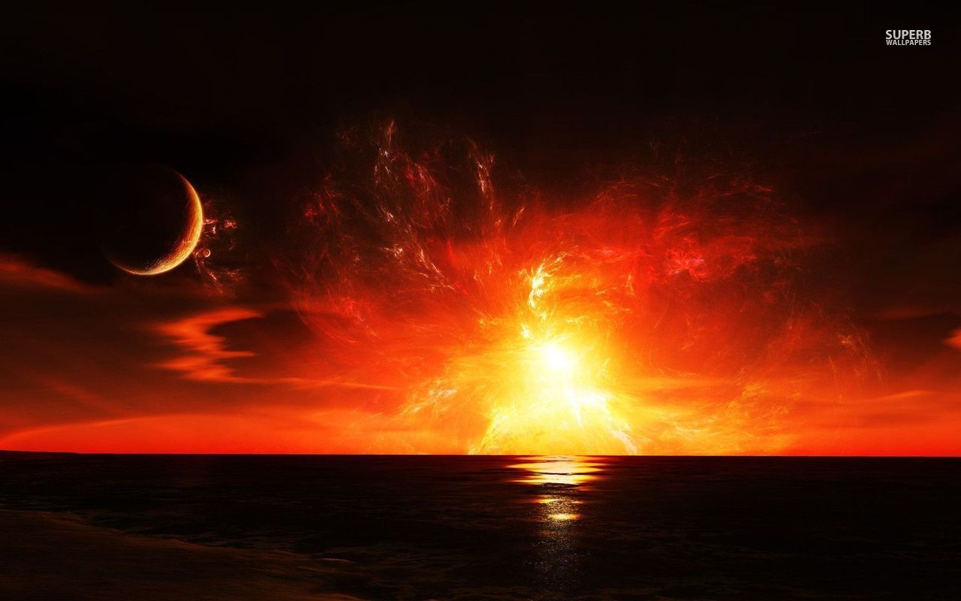
Second Trumpet (8:8, 9)
Image of A burning mountain being cast into the sea
1/3rd of sea and all that lived in it were destroyed
mountain symbolizes power (Is. 2:2)
Babylon was referred to such by Jeremiah (Jer. 51:24, 25)

Slide 8
Second Trumpet (8:8, 9)
The effect is what is important
  similar to the first plague against Egypt—against the waters
  Exodus 7:20, 21

Slide 9
Second Trumpet (8:8, 9)
The Point?
against food supply—much of the population looked to the sea for such
against the influence of Rome over the mass of humanity (Rev. 17:1, 15)
against Rome’s Naval power

Slide 10
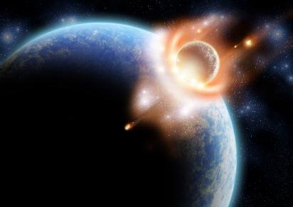
Third Trumpet (8:10, 11)
2nd trumpet—burning mountain—sea
3rd trumpet—burning star—inland waters
The result: waters were made bitter and many men died
Wormwood—a plant associated with the bitterness of disobedience
  Deuteronomy 29:16-19; Proverbs 5:1-14; Jeremiah 9:14, 15
  Many will perish in their bitterness

Slide 11
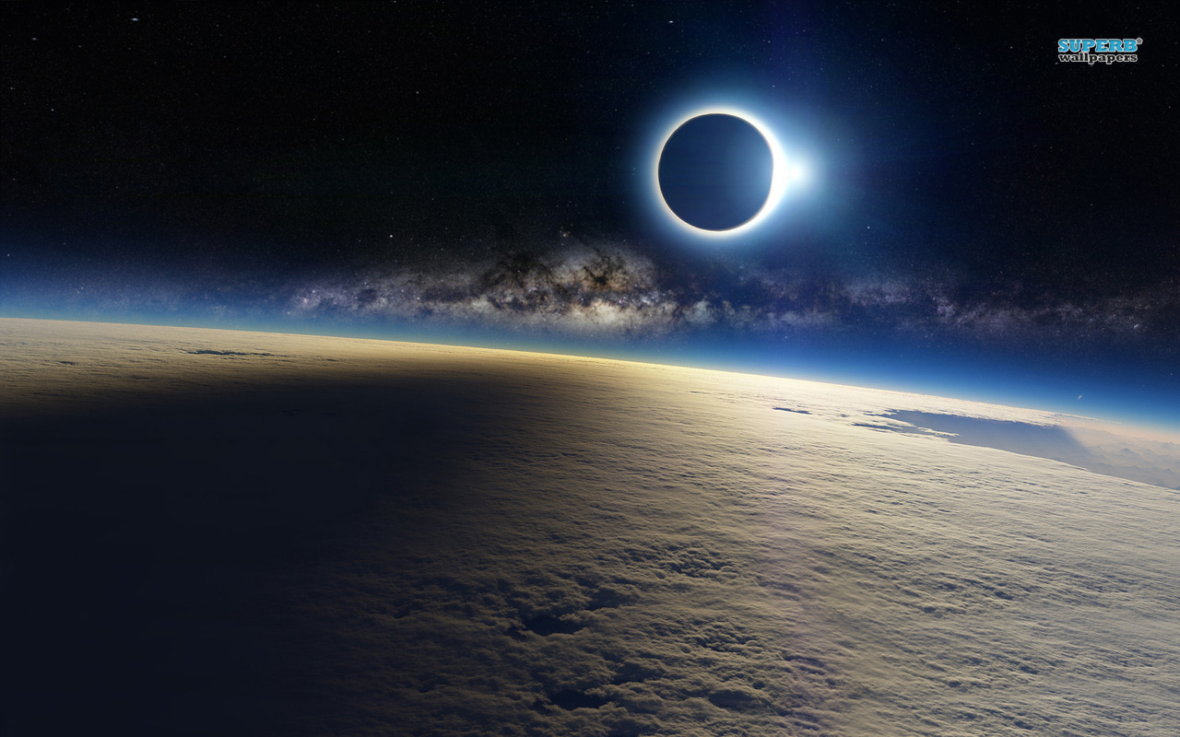
Fourth Trumpet (8:12)
Then the fourth angel sounded: And a third of the sun was struck, a third of the moon, and a third of the stars, so that a third of them were darkened. A third of the day did not shine, and likewise the night”
Heavenly bodies (light bringers)
assaulted (cf. Ex. 10:22)
  1/3rd sun
  1/3rd moon
  1/3rd stars

Slide 12
Fourth Trumpet (8:12)
“Darkening” of the heavenly bodies has the meaning of judgment
  Joel 2:1-11
  Amos 5:8, 20

Slide 13
3 Woes (8:13)
Many versions have “eagle” in place of “angel”
  eagles—symbols of defeat & swift destruction (Matt. 24:28; Hos. 8:1; Hab. 1:8)
“Woe” is an exclamation of grief
  the three woes are in reference to the following three trumpets
  meaning: the worst is yet to come

Slide 14
Applications
Sin affects everything!
Calamities may be a way that God is warning us (Gen. 3:17; 7:11; 19:12ff; Amos 4:6-12; Hag. 2:17; etc.)
Such calamities ought to remind us that, “This world is not our home!”

Slide 15
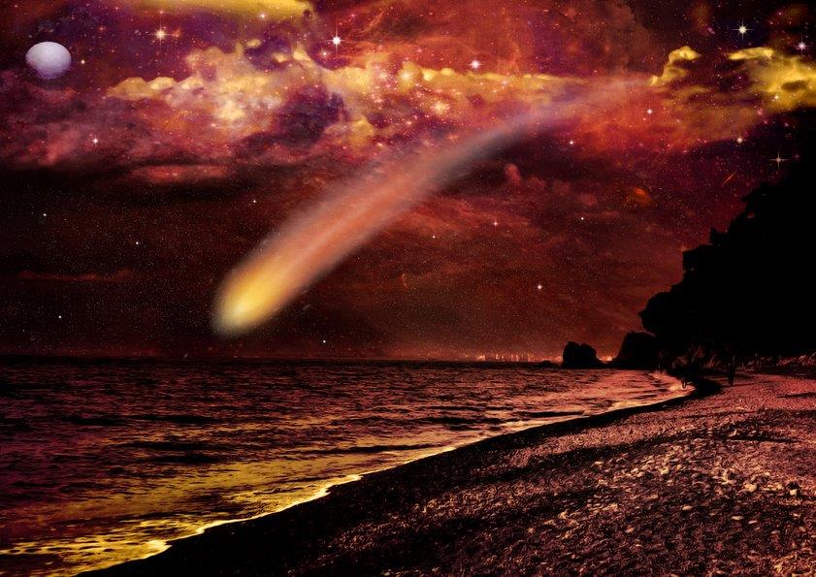
Fifth Trumpet (9:1-12), 1st WOE
Let us not get lost in the brush stroke so as to fail to see the portrait!
Star falls from heaven
  Satan?
  Satan is not the one with the keys to the bottomless pit (cf. 20:1, 2)
  angel seems to serve as a king to the locusts (9:11)

Slide 16
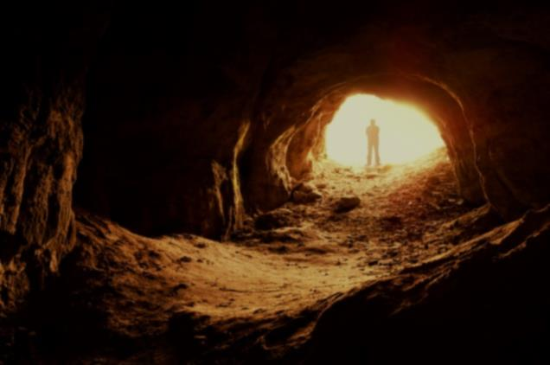
Out from the pit (9:2, 3)
a bottomless pit
smoke comes out so that the sun and air are darkened (Col. 1:13; 2 Cor. 4:4)
  Parallel kingdom becoming full of darkness of fifth bowl (16:10)
  Smoke of deception, moral wickedness, delusion
from smoke come locusts with the power of scorpions
  Psalm 78:46

Slide 17
The Locusts (9:4-11)
not to harm what locusts would normally harm (v. 4)
to harm men (v. 4)
  Christians spared from (cf. sealed 7:3, 4)
  Distinction between God’s people and His enemies (Exodus 8:22, 23; 9:4, 6, 26; 10:22, 23; 11:7; Mal. 3:16-18)

Slide 18
The Locusts (9:4-11)
A limited “torment” to sinners (9:5)
  Likely to call them to repentance
  In this life often punished by our sins and not yet for our sins
  Likely a torment associated with their unforgiven sin and their resistance to righteousness (cf. 11:10; Rom. 7:24; cf. Is. 8:16-9:2; Ps. 32:1-4)

Slide 19
The Locusts (9:4-11)
their purpose: to “torment,” not “kill”
(vv. 5, 6)
  torment of scorpions—agonizing, distressing (cf. 1 Kin. 12:10, 11)
  men would seek death but not find it
their duration: 5 months
  5 = ½ of 10
  10 means complete/fullness (cf. 2:10)
  5 would indicate that God’s punishment would not be completed in this “woe”

Slide 20
The Locusts (9:4-11)
their appearance (vv. 7-10)
  “as” and “like”
  shape like horses prepared for battle:
  fast and fearless
  wore crowns of something like gold: victorious
  faces like the faces of men: intelligence
  hair like that of women: long, beautiful and in other ways perhaps grotesque

Slide 21
The Locusts (9:4-11)
their appearance (vv. 7-10)
  teeth like lions: fierceness
  breastplates like iron: preparation, protection, seemingly invincible
  sound of wings like chariots with many horses: loud and unnerving
  tails like scorpions: dreadful

Slide 22
The Description
Likely a description of Rome’s internal corruption which begets corruption
  Internal decadence was one of the leading causes of Rome’s downfall
  Romans 1:18-32
  Sow/reap principle
    Gal. 6:7, 8; Hos. 8:7; Prov. 22:8

Slide 23
The Locusts (9:4-11)
Their King (v. 11)
  the angel of the bottomless pit
  Abaddon –destruction
    often associated with Hebrew “sheol” and “death” (Job 26:6; 28:22; Prov. 15:11; 27:20)
  Apollyon”–destroyer
If their king was “destroyer” it should be evident that their primary work was that of destruction!

Slide 24
The Point Of The Fifth Trumpet
Sin may look enticing at first but it will require an ugly price to pay
Sin sown is guaranteeing sorrow to be reaped
Sin results in destruction
  body, mind, and soul
  Ps. 32:1-4; 38:1-11; Deut. 28:67; Is. 57:20

Slide 25
Sixth Trumpet (9:13-21), 2nd WOE
4 horns of golden altar (v. 13)
  same golden altar as in 8:3-5
  (prayers and incense)
  a voice was heard—an answer from God to prayers

Slide 26
The Message (v. 14)
release 4 angels—probably military force
possible categories…
  First four trumpets:
    announce natural calamity
  Fifth trumpet:
    announce internal destruction
  Sixth trumpet:
    announce external affliction

Slide 27
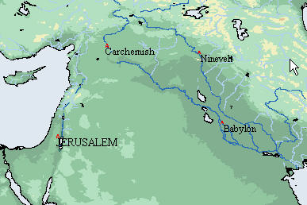
The Message (v. 14)
Bound at the great river Euphrates
  great powers came from across the Euphrates to chasten and conquer Israel in the past (Is. 8:5-8)
  Babylon wrecked an
  Egyptian/Assyrian
  alliance at
  Carchemish on
  the Euphrates
  about 605 BC
  (2 Chron. 35:20; Jer. 46:1ff; 2 Kin. 23:29; 24:7)

Slide 28
The Message (v. 14)
Bound at the great river Euphrates
  Euphrates dried up so that way of the kings of the east would be prepared (16:12)
  Suggested Parthians against Rome (Robert Harkrider)
  God brings foreign forces because He is ruler of the kings of the earth (1:5)
The main point: imminent danger has access and death is near!

Slide 29
Prepared (v. 15)
When?
  prepared for the hour, day, month, year
  time, exact and fixed in the mind of God
Why?
  1/3rd of mankind killed
  this trumpet is not about torment, but death
  1/3 —limited—partial—great loss of life

Slide 30
The number of the army (v. 16)
200,000,000
  “two myriads of myriads” (LO, IGNT)
  “two hundred thousand thousand” (KJV)
  “twice ten thousand times ten thousand” (ASV)
  2 X 10,000 X 10,000
  Point: God has overwhelming resources to punish evil

Slide 31
The Horses (9:17-19)
“in the vision” —a reminder of the symbolic nature of the book
riders with breastplates of fiery red, hyacinth blue, and sulfur yellow

Slide 32
The Horses (9:17-19)
heads like lions—power and strength
from mouth similar colors
  fire
  smoke
  brimstone
THREE ELEMENTS of DESTRUCTION
(Gen. 19:24; Ps. 11:6; Is. 34:9, 10)
Three = divine justice
THESE KILLED 1/3RD OF MANKIND

Slide 33
The Horses (9:17-19)
power of the horses
  in their mouth (lions)
    To injure what is in front of them
    Face down what opposes them like a lion
  in their tails (serpents)
    To injure what is behind them
    Reminiscent of the tails of the locusts (9:10)

Slide 34
The Horses (9:17-19)
Symbolic of warfare (as the horsemen of the seals 1-4)
  A society collapsing on itself from within and without
Not literal creatures but symbols
Not addressing modern warfare: flamethrowers, tanks, and missiles

Slide 35
Robert Harkrider
“It must be understood that this is symbolical language and that all these details are given to dramatize the pageantry. …The invasions from insects and armies, coming like organized military forces, spread hurt and death everywhere. They represent the heavy toll that violence exacts upon society. Whether internal or external, this collapse finds its main cause in man’s rejection of God’s value system. Men bring this killing curse upon themselves.”
Truth Commentary, p. 111

Slide 36
The Point:
the collapse of an empire from internal and external forces
  when people reject values outlined in the Christian religion, they are left for sorcery, murder, sexual immorality and thefts
  as the foundations that respect life, fellow man and authority erode, so crumbles the family, society, and the empire
    Romans 1:18-32

Slide 37
The Reason For Woes In Revelation
REPENTANCE (9:20, 21)
  God is longsuffering but man often fails to learn from suffering (2 Pet. 3:9)
  these verses fall into some of the saddest words of the Bible
  despite God’s warnings and chastisements, the rest of mankind would not repent

Slide 38
Without Repentance
worship of demons/idolatry
murders
sorceries (drugs, Gk. pharmakeia )
sexual immoral ways
thefts
Despising God
Despising life & fellow man
Despising reality & self control
Despising family
Despising property rights

Slide 39
Without Repentance
worship of demons/idolatry
murders
sorceries (drugs, Gk. pharmakeia )
sexual immoral ways
thefts
Such are commonplace in a culture which rejects repentance
True repentance
  change of the HEART & THOUGHTS
  a positive change of ACTION (Acts 26:14-20; Eph. 4:22-29)

Slide 40
Lessons
Sin is against the Creator
A rejection of God
A rejection of His laws
A cascading decline (Rom. 1:25-28)
  Exchanged truth
  Embraced idols
  Entered corruption

Slide 41
Lessons
Sin is against the Creator
Sin is terrible and destructive
Should be evident:
  In a broken home
  In sleepless guilt of the conscience of one who lied
  In the church divided by the self-willed
  In the wake of a drunk
  In a murder scene
  Etc.

Slide 42
Lessons
Sin is against the Creator
Sin is terrible and destructive
If we are to benefit from God’s mercy, we must hear and repent
Suppressing the warnings equal self destruction
  Recall Harry Truman’s refusal to heed the warnings
Ps. 32:8,9; Jer. 6:10, 16-25; Zech. 7:10-14; Matt. 13:14-16

Slide 43
Intermediate Visions 10:1 – 11:14
mighty angel with little book (10:1-11)
the two witnesses (11:1-14)

Slide 44
A Mighty Angel
With A Little Book
Revelation 10:1-11

Slide 45
Purpose of Chapters 10 & 11
To appreciate the word of God (10)
To move forward with the word of God (11)
  In inspecting ourselves
  Answers: In preaching in the face of perilous times what is the church supposed to do?

Slide 46
A Mighty Angel (10:1)
compare 5:2 & 18:21
commentaries are divided over identifying the angel
  Christ (cf. 1:16)
    improbable
    “another” associates this being with the other angels (9:15; 5:2)
    swears by Him who created all things (10:6)
  a strong angel of high authority—a delegate of Christ

Slide 47
A Mighty Angel (10:1)
clothed in a cloud
  may symbolize angel’s work as glorious and will be manifest to many (cf. 1:7)
  may symbolize righteousness and judgment (Ps. 97:2)
rainbow on head
  covenant (Gen. 9:12-17)
  encircled the throne (Rev. 4:3)

Slide 48
A Mighty Angel (10:1)
face like the sun
  image often associated with Jesus
  also true of angels in general (2 Cor. 11:14)
pillars of fire
  often a characteristic of God
  probably symbolic of powerful destruction (Is. 29:6)

Slide 49
A Mighty Angel (10:2)
little book in hand
  probably not book in chapter 5
  different Greek word bibliaridion
  a small book that is seen as opened, not sealed—available (cf. 2 Pet. 1:3)
feet on land and sea
  three times (10:2, 5, 8)
  colossal image
  message is for whole world (cf. 10:11)

Slide 50
Seven Thunders (10:3, 4)
angel cried with loud roar (lion like)
seven thunders respond (perhaps Jehovah’s response to angel)
question #3
  John heard but wasn’t permitted to write it down (cf. 2 Cor. 12:4)
  shows that God doesn’t “reveal” everything about Him or His ways
  some things are confidential to heaven

Slide 51
Deuteronomy 29:29
“The secret things belong to the Lord our God, but those things which are revealed belong to us and to our children forever, that we may do all the words of this law”
Lesson: Let us respect the silence and secrets of God and stand in what is revealed.
See also Isaiah 55:8, 9, John 20:30, 31, 2 Timothy 3:16, 17; Mark 13:32.

Slide 52
The Mighty Message (10:5-7)
question #4
  Cf. Gen. 14:22, 23; Deut. 32:40; Dan. 12:7
“time” has run out; repentance was not sought (9:20)
God’s longsuffering has expired, “there should be “delay” no longer”

Slide 53
The Mighty Oath (10:6)
by the eternal nature of God
by the creative hand of God
  both of these are real reasons for worshiping Jehovah
  both stand and fall together in scripture
  if someone can dismiss one, why not dismiss the other?

Slide 54
The Mystery of God (10:7)
a mystery is only mysterious until its fullness is revealed (see Rev. 1:20)
  Not something which only a select few with special knowledge can apprehend
  Something which would never be understood unless God reveals it
  (cf. Col. 1:26)

Slide 55
The Mystery of God (10:7)
question #5
  mystery will be completely revealed and resolved in the seventh seal

Slide 56
The Mystery of God (10:7)
was spoken by the prophets:
  during 4th kingdom, God would set up His kingdom (Dan. 2:40, 44)
  His kingdom begins after Messiah’s ascension (Dan. 7:13, 14)
  4th kingdom (Rome) would begin to prevail over saints (Dan. 7:15-21)
  saints would ultimately possess the kingdom and the beast would be defeated (Dan. 7:22-27)

Slide 57
Extra: What are some mysteries revealed in the New Testament?
The gospel (Eph. 6:19)
The resurrection (1 Cor. 15:51)
The entire scheme of redemption (Rom. 16:25-27)
The Gentiles coming in (Rom. 11:25; Eph. 3:4-11)
The relationship of Christ to the church (Eph. 5:32)
Godliness (1 Tim. 3:16)

Slide 58
The Mighty Directions (10:8-11)
question #6
eating the small book (cf. Ezek. 2:8-3:4)
  both times to eat before preach/prophesy
  both times it tasted like honey
    God’s word is sweet
    (Ps. 19:10; 119:103)
    should be a joy to consume God’s word
    (Jer. 15:16)
    Matthew 4:4

Slide 59
(Job 23:12)
“I have not departed from the commandment of His lips; I have treasured the words of His mouth more than my necessary food”

Slide 60
Sweet & Bitter (10:10)
God’s word is sweet to taste and can become bitter once eaten (cf. Ezek. 3:14; Jer. 20:8, 9)
question #7(b)
many begin the race with joy, hope and excitement but become disheartened and frustrated along the way
  frustrated with self
  frustrated with brethren/false brethren
  frustrated with family
  frustrated with opposition

Slide 61
The Bitter-sweet Message
often rejected by men
  Isaiah 30:10
continues to be rejected by men
  2 Timothy 4:2-5
modern mindset: “Emphasize the positive and eliminate the negative”
  Equals: “Emphasize the honey and eliminate the bitter”
  Equals: a rejection of God’s word

Slide 62
Why Would The Book Become Bitter To John?
question #7(a)
That troublesome times are here
That he was to expose sin
That he was to expound on judgment and punishment to come
That most would reject his message
That many would persecute the messenger

Slide 63
John’s Mission (10:11)
Not over yet
must yet prophesy “again” to many people
the gist of the “little book” is found in the remaining visions in Revelation

Slide 64
Two Witnesses
Revelation 11:1-14

Slide 65
Question #1
What was John to measure? What was he not to measure?
  Measure the temple, the altar, the worshippers
  Do not measure the court which is outside

Slide 66
Question #2
Are we to assume this chapter is speaking of two literal witnesses, a literal measuring reed, the literal temple, altar and earthly city of Jerusalem?
  If not, what might some of these things represent in this vision? Provide evidence for your answer.

Slide 67
Measuring the “Temple of God” (11:1, 2)
guard against assigning a literal interpretation to a symbolic text
  Earlier John was commanded to eat the book (10)
  Now he is to measure the temple
    comparable act to that of sealing of the saints (7:3)
    the purpose in measuring is that of “protection” of the righteous (cf. Zech. 2:1-5)

Slide 68
Identifying the Symbols (11:1, 2)
Temple
  Physical temple in Jerusalem (AD 70 Advocates)
  A rebuilding of a physical temple in Jerusalem (Premillennialists)
    Why do some insist on a restoration of what was considered “weak and beggarly” by the apostles? See Galatians 4:9
    If temple literal, then altar, two witnesses and 42 months are literal!

Slide 69
Identifying the Symbols (11:1, 2)
Temple
  The physical temple in Jerusalem serves as the backdrop of the spiritual temple on earth in John’s day
  What temple is that?

Slide 70
Identifying the Symbols (11:1, 2)
The NT temple on earth is the church
  “. . .you are God’s building. . .” (1 Cor. 3:9)
  “Do you not know that you are the temple of God and that the Spirit of God dwells in you? If anyone defiles the temple of God, God will destroy him. For the temple of God is holy, which temple you are” (1 Cor. 3:16, 17)
  “. . .a spiritual house. . .” (1 Pet. 2:5)
  See Ephesians 2:21-23
There is also a temple “in heaven” (11:19)

Slide 71
No Concern Over Physical Temple
But of the living stones to overcome
  “He who overcomes, I will make him a pillar in the temple of My God, and he shall go out no more. And I will write on him the name of My God and the name of the city of My God, the New Jerusalem, which comes down out of heaven from My God. And I will write on him My new name” (Rev. 3:12)

Slide 72
Identifying the Symbols (11:1, 2)
The reed
  a measuring device like a staff
  represents a standard of truth by which religious deeds are done; either in Christ or out of Christ
  The word of God is what measures us
    John 12:48
    If it measures us in the last day, it surely measures us today!

Slide 73
Identifying the Symbols (11:1, 2)
The altar
  place of prayer & prayers of saints
  (6:9-11; 8:3, 4)

Slide 74
Identifying the Symbols (11:1, 2)
“those who worship there” –priests → saints!
  1 Peter 2:4-5, “Coming to Him as to a living stone, rejected indeed by men, but chosen by God and precious, you also, as living stones, are being built up a spiritual house, a holy priesthood, to offer up spiritual sacrifices acceptable to God though Jesus Christ”
  the significance of the altar being measured is understood by who alone worked there—priests
    All NT saints are priests and they serve around the altar offering up spiritual sacrifices

Slide 75
Identifying the Symbols (11:1, 2)
Refusing to measure the outer court
  view: people in outer court may “appear” to be God’s children but not genuine; not faithful; etc.
  alternative: idea may have reference to not protecting the outward man (outer courts), but saving the inward man (temple)
  the bitter-sweet quality of the message is seen in either (chapter 10)

Slide 76
Identifying the Symbols (11:1, 2)
Treading the “holy city”
  not destruction of literal Jerusalem
  “holy city” is the church (cf. 21:2)
    the “heavenly Jerusalem” (Heb. 12:22, 23)
    the “Jerusalem above” (Gal. 4:26)
    the church will be tried and trampled but as the temple of God it will remain
  a message of heartache and hope

Slide 77
Question #3
How long would the holy city be trodden underfoot? What are other expressions of this time period?

Slide 78
Identifying the Symbols (11:1, 2)
MEANING: God was going to allow the church to be persecuted for 42 months,
“He shall speak pompous words against the Most High, shall persecute the saints of the Most High. . .then the saints shall be given into his hand for a time and times and half a time” (Dan. 7:25)
These are equal expressions
What is the significance of these expressions?

Slide 79
NUMEROLOGY
The 3 Expressions Mean The Same Thing!
“42 months” (11:2; 13:5)
“1260 days” (11:3; 12:6)
“a time, times, ½ a time”
(Dan. 7:25; Rev. 12:14)
42 months = 42 X 30 days = 1260 days
a time, times, ½ time
(1) + (2) + (½) = 3 ½
yr. yrs. yr. yrs.

Slide 80
Question #4
What significant number is tied to decrypt these expressions?

Slide 81
Numerology
3 ½
Decrypting the message is tied to the number “7” (complete)
  7 Churches (2-3)
  7 Spirits & Stars (3:1)
  7 Seals (6:1 – 8:5)
  7 Trumpets (8:6 – 11:19)

Slide 82
Numerology
3 ½
3 ½ = 7/2 (½ of 7)
  a short, broken, finite period of time
  often associated with hardship and trial
    (Jas. 5:17; Lk. 4:25; Rev. 13:5)
  implies a hope—trial is limited
    despite suffering hardship, God’s people will be nourished
    though victimized and killed, God’s faithful people will be victorious conquerors—spared from the second death
    banished by men—not forgotten by God

Slide 83
The Meaning of 11:2
Since Daniel first spoke of “a time and times and a half of time” (7:25); we need to connect Revelation to what Daniel prophesied.
  Daniel spoke of saints being persecuted by the beast for a period of time (3 ½ yrs.)
  John is seeing the beast that Daniel spoke of (13:1-5)
  God’s people, the church, would be trodden under by the beast for a symbolic 3 ½ years

Slide 84
The Meaning of 11:2
God is giving his people perspective
During the symbolic 3 ½ years
  the beast will trample the church and speak blasphemies for 42 months (11:2; 13:5)
  See question #5
    Two witnesses will prophesy (preach gospel) during this time (1260 days 11:3)
    The church (woman) will be “…nourished for a time and times and half a time, from the presence of the serpent” (12:6, 14)

Slide 85
The Work of the Two Witnesses (11:3-6)
Work of prophesying as witnesses (11:3)
  to preach for God and Christ and against sin (Rev. 11:10; 1:2; 12:17; 20:4)
  God’s people were not to be silent during troublesome times, but outspoken

Slide 86
The Identity of the Two Witnesses (11:3-6)
Nothing in text to identify who the witnesses are
  “two” is code for “strength” (Eccl. 4:9-12)
  “competent and strong testimony with “two” (Deut. 17:6; 19:15; Heb. 10:28; 1 Tim. 5:19)
  Jesus sent His disciples out in pairs of “two” (Lk. 10:1)
Will seek to identify later…

Slide 87
The Clothing of the Two Witnesses (11:3-6)
Wearing sackcloth (11:3)
  a rough cloth usually of animal hair
  (Gospel For Today Commentary)
  symbolic for mourning/hardship
  (Is. 22:12)
  symbolic clothing for calling men to repent

Slide 88
The Strength of the Two Witnesses (11:3-6)
Two olive trees and lampstands (v. 4)
  standing before the God of the earth
    focus is to please the One they stand before (1 Cor. 9:16; 1 Thess. 2:3-5)
  lampstands are light
  olive trees provide the source for the light
  light is symbolic for being a faithful Christian (Matt. 5:14-16; Phil. 2:15)

Slide 89
The Strength of the Two Witnesses (11:3-6)
Zechariah 4:1-14
  “Then he answered me and said, ‘Do you not know what these are?’ And I said, ‘No, my lord.’ So he said, ‘These are the two anointed ones, who stand beside the Lord of the whole earth’” (Zech. 4:13, 14)
  Likely Joshua (priestly) and Zerubbabel (regal) in rebuilding the temple of God
  Point of chapter is that assurance of success is through God’s help (Zech. 4:6)

Slide 90
The Opposition of the Two Witnesses (11:3-6)
In danger of harm (v. 5)
  those who oppose their message are “enemies”
    the word judges the hearts of men (Heb. 4:12; Jn. 12:48)
    preaching the word judges men → men opposed being judged → opponents become enemies of preachers and of God
    error always opposes truth (Jn. 3:19, 20)

Slide 91
The Opposition of the Two Witnesses (11:3-6)
In danger of harm (v. 5)
  if (when) anyone “wants” to harm them then they will be destroyed with fire from which proceeds from their mouths
    fire is from their mouths—Jeremiah 5:14
    to oppose gospel preaching is to do so at your own peril (2 Thess. 1:7-9)
    What is the message of “hellfire” to the unrighteous?

Slide 92
The Power of the Two Witnesses (11:3-6)
Power to shut heaven, so no rain falls (11:6)
  Like Elijah (Lk. 4:25)
Power over waters to turn to blood, strike earth with plagues (11:6)
  Like Moses (Ex. 7-10)

Slide 93
So Who Are They?
Are they literally Joshua and Zerubbabel?
  NO!
Are they literally Elijah and Moses?
  NO!
Are they the Law and the Prophets?
  NO!

Slide 94
Ask:
What would the original readers think?
What did the two witnesses do 11:7?
  “TESTIFIED”
  Has there not already been testifying?
    See 1:1, 2, 9; 6:9; 12:11, 17
    Was testifying the act of a select few or all the members of the church?

Slide 95
Ask:
How are the two witnesses described (11:4)?
  Olive Trees and Lampstands!
  Have there been lampstands already and what were they?
    "The mystery of the seven stars which you saw in My right hand, and the seven golden lampstands: The seven stars are the angels of the seven churches, and the seven lampstands which you saw are the seven churches” (Rev. 1:20)
Every member of the body of Christ is to supply light to the world (Mat. 5:14-16; 2 Cor. 4:6; Eph. 5:8; Phil. 2:15)!

Slide 96
Ask:
What do the olive trees mean?
  The two olive trees were in code for the regal work of Zerubbabel and the priestly work of Joshua (Zechariah 4)
  Have there been any kings and priests thus far?
    “and has made us kings and priests to His God and Father, to Him be glory and dominion forever and ever. Amen.” (Rev. 1:6; cf. 5:10)

Slide 97
Ask:
Does anyone want to harm the witnesses (11:5)?
Has anyone been harmed so far?
  See 1:9; 2:9, 10; 3:10; 7:14

Slide 98
Ask:
Were the two witnesses killed (11:7)?
Were there any killings already going on?
  See 2:13; 6:9
  More would die 6:11

Slide 99
Identity…
“…Who would Christians in John’s day have believed the two witnesses were? Their first thoughts would surely have been of Christian friends who had already died for the faith. Then, as they continued to think about it, wouldn’t they have realized that the scenario outlined their own future?”
(Truth For Today Commentary, Revelation 1-11, p. 430)

Slide 100
Identity…
All Christians who would yet take a stand against the error of Rome and who were willing to suffer death for their allegiance to Christ
Hinted at in 11:7, “…the beast that ascends out of the bottomless pit will make war against them…”
  Concept of “war” is not seen so much in the death of two people but in hundreds or thousands!

Slide 101
Numbers
To argue that “two” must literally be “two people” in Revelation is like arguing:
  There were only seven churches in Asia
  That Smyrna would have tribulation for literally ten days
  That the trampling of the church would only last a literal 42 months
  That there is a literal 1000 year reign
“Two” is a code word for strengthening

Slide 102
The Death of the Witnesses
(11:7-10)
“finished their testimony”
  gospel was preached
  great commission was accomplished (Mk. 16:15, 16; Col. 1:23; Matt. 28:18, 19; Rom. 16:26)
“beast that ascends out of bottomless pit”
  Rome under satanic power (13:2, 7)

Slide 103
The Death of the Witnesses
(11:7-10)
“make war. . .overcome. . .kill”
  intense persecution of saints
“dead bodies lie in the street”
  utter contempt
  depicts the temporary halt to the widespread work of evangelism (Warnock)

Slide 104
The Death of the Witnesses
(11:7-10)
the “great city” (11:8) is contrasted with the “holy city” (11:2)
The great city is spiritually:
  Sodom – moral decay
  Egypt – bondage
  “Where our Lord was crucified”
    Jerusalem, rejection of truth and killed those sent to her (cf. Matt. 23:34-37)
If spiritually, then this is spiritually!

Slide 105
The Death of the Witnesses
(11:7-10)
bodies would be seen 3 ½ days
  meaning a short time
earth rejoiced (v. 10)
  these are the “peoples, tribes, tongues, nations” (v. 9)
  the world was elated at the death of these witnesses
    rejoice
    make merry
    send gifts

Slide 106
Question #6, Why So Happy
(v. 10)?
because the two witnesses tormented them (through preaching)
because men love darkness & would not repent (9:20, 21)
  1 Kings 22:8
  Proverbs 1:29
  Amos 5:10
  Isaiah 30:9-11
  John 3:19, 20

Slide 107
The Resurrection of the Witnesses
(11:11-14)
Question #7
Celebration over the death of two witnesses was only momentary (3 ½ days)
God resurrected the witnesses
  great fear fell on those who saw
  probably a resurrection of cause/vindication
  (cf. Ezek. 37:1-14)

Slide 108
The Resurrection of the Witnesses
(11:11-14)
Witnesses ascended to heaven
Same hour there was an earthquake
  may be natural calamity
  may be upheaval of political powers
  1/10th of the city fell –partial judgment
  7000 died –God’s judgment consumed all that He desired to die

Slide 109
Revelation’s Story in a “Nutshell”
God’s word is preached in a bold fashion
  invasive to society’s sins
Persecution of some form follows the preaching of God’s word
God performs some judgment upon the wicked after the preaching and persecution
Many others see the power of God and glorify Him

Slide 110
Seventh Trumpet –Third Woe (11:14-19)
Emphasis: victory of saints; destruction of wicked
Mystery of God finished (cf. 10:7)
  finished in the truth that, “the kingdoms of the world have become the kingdoms of the Lord and His Christ” (Rev. 11:15)
  the mystery of Daniel 7:15-18, 27
Question #8

Slide 111
11:15
“The kingdom of this world…” (ASV)
  Often influenced and works within the authority of Satan (Jn. 12:31)
  Preaching the gospel in the world draws men out of Satan’s kingdom and into Christ’s (Col. 1:9-14)
  Jesus defeated Satan during His personal ministry (Heb. 2:14)
  The church continues to extend that defeat through her obedience (Rom. 16:19, 20)

Slide 112
11:15
“is become the kingdom of our Lord, and of his Christ…” (ASV)
  Revelation 15:4
  Psalm 22:27, 28; 72:11; 86:9
  Isaiah 2:2, 3
  Jeremiah 16:19
  Daniel 2:44
  Zechariah 2:11; 8:20-23; 14:9
  Matthew 28:18-20

Slide 113
Question #9
Does Revelation 11:15, 17 teach that God has not reigned until the end of the Christian Age?
Does it teach that God will establish His kingdom on earth when Jesus returns?

Slide 114
False Positions Not Taught in Revelation 11:15, 17
That God has not reigned until the end of the Christian Age
  God has reigned over all the creation since He made it (Ps. 10:16; 29:10)
That God’s kingdom will be established when Jesus comes again
  John was already in the kingdom when he began writing this book (1:9; see also Rev. 3:21; Mk. 9:1)

Slide 115
24 Elders
Familiar image (4:4; 4:10; etc.)
  Return to the throne (scene)
  24 = 12 + 12 (probably 12 tribes of Israel and 12 apostles)
  They understand the final outcome—while all who oppose the Christ and His church may have some limited success, they will eventually be defeated by the wrath of God

Slide 116
11:17, 18
Praised as creator (Rev. 4)
Praised as redeemer (Rev. 5)
Praised as conqueror/king (Rev. 11)
“A ‘table of contents’ for the remainder of the Book of Revelation” (Wiersbe, Warren, The Bible Exposition Commentary, Vol. 2)
11:18 as reference to Psalm 2:1-6
  Why are the nations angry?
  Wrath and reward are consistently found in judgment
Notes:
The nations are angry because they want to do things there way and do not want to be judged. The defiance of the nations will continue to be seen in Revelation. But there is an anger which is far worse and that is God’s wrath. He will destroy those who destroy the earth (cf. Gal. 6:7). See God wrath in (Rev. 14:10; 16:19; 19:15).

Slide 117
11:17, 18
There may be a double fulfillment of this woe forecasted in the end
  (cf. promise to David was immediately fulfilled in Solomon but more fully in the Messiah, 2 Sam. 7:11-17)
Likewise, there will be a time when:
  None will oppose Christ but all will confess Him (Rom. 14:11; Phil. 2:10)
  All the dead will be judged and all the righteous will be rewarded (Rev. 20:11-15)

Slide 118
Temple of God Was Opened (v. 19)
Compare 4:1
The ark of the covenant is seen
Beware of literal approach to symbolic vision

Slide 119
Sabbatarian Error
Assume ark is literal ark of Moses’ time
Faulty premise leads to faulty conclusion:
  ark is literal
  ark is in heaven
  10 commandments in ark (Deut. 10:5)
  therefore 10 commandments will be kept in heaven
  if in heaven, then must be in church

Slide 120
Sabbatarian Error
Ignore fact that heaven is not a material place
  why would a material ark be in a place that is not material?

Slide 121
Sabbatarian Error
Ignore the fact that things are in heaven that are not in the church on earth & vice versa:
  angels in heaven but not in church (Heb. 2:16)
  sight in heaven; faith on earth (2 Cor. 5:7; 1 Jn. 3:2)
  little children (mortalities on earth) will be in heaven but not in church
  Lord’s Supper in church but not in heaven
  (1 Cor. 11:26)

Slide 122
Sabbatarian Error
Ignores that the Sabbath was only given to Israel
Ignores that it was given to people in Egyptian bondage
Ignores that it was a sign between God and one nation, Israel

Slide 125
Ezekiel 20:12
“Moreover I also gave them My Sabbaths, to be a sign between them and Me. . .”

Slide 126
Sabbatarian Error
Ignores that the Sabbath along with other holy days were taken away (Col. 2:14-17)
Ignores that it was “done away”
Ignores that we were delivered from it
Ignores that Sabbath-keeping was under an obsolete system

Slide 127
"What shall we say then? Is the law sin? Certainly not! On the contrary, I would not have known sin except through the law. For I would not have known covetousness unless the law had said, 'You shall not covet'."
WHAT LAW?
ROMANS 7:7

Slide 128
Romans 7:4, 6
"Therefore, my brethren, you also have become dead to the law through the body of Christ, that you may be married to another. . . But now we have been delivered from the law, having died to what we were held by. . . "

Slide 129
"TABLETS OF THE COVENANT" WERE OF THE FIRST COVENANT
(HEB. 9:1-5)
AND
"He takes away the first that He may establish the second" (Heb. 10:9)
"In that He says, 'A new covenant,' He has made the first obsolete. Now what is becoming obsolete and growing old is ready to vanish away" (Heb. 8:13)

Slide 130
"And such trust have we through Christ to God-ward: Not that we are sufficient of ourselves to think any thing as of ourselves; but our sufficiency is of God; Who also hath made us able ministers of the new testament; not of the letter, but of the spirit: for the letter killeth, but the spirit giveth life. But if the ministration of death, written and engraven in stones, was glorious, so that the children of Israel could not stedfastly behold the face of Moses for the glory of his countenance; which glory was to be done away: How shall not the ministration of the spirit be rather glorious? For if the ministration of condemnation be glory, much more doth the ministration of righteousness exceed in glory. . .”

Slide 131
“. . .For even that which was made glorious had no glory in this respect, by reason of the glory that excelleth. For if that which is done away was glorious, much more that which remaineth is glorious. Seeing then that we have such hope, we use great plainness of speech: And not as Moses, which put a vail over his face, that the children of Israel could not stedfastly look to the end of that which is abolished: But their minds were blinded: for until this day remaineth the same vail untaken away in the reading of the old testament; which vail is done away in Christ"
(2 Cor. 3:4-14, KJV).

Slide 132
Could We Keep the 10 Commandments in Heaven?
work six days and rest one (Ex. 20:9)?
honor father and mother? Will it help longevity (Ex. 20:12)? This purpose is in the 10 commandments so won’t it be in heaven?
threat of murder (Ex. 20:13; Rev. 21:8, 27; 22:15)?

Slide 133
Could We Keep the 10 Commandments in Heaven?
will there be a possibility of adultery
(Ex. 20:14; Matt. 22:30)?
will thieves exist there (Ex. 20:15)?
will there be “servant” and “animals” to covet (Ex. 20:17)?

Slide 134
Proper Understanding of the Ark in John’s Vision (11:19)
The “ark” symbolized “covenant”
  God would not forget His covenant
  God would not forget those in His covenant

Slide 135
Concluding Remarks on
Revelation 1-11
Not written in chronological order
Written in a recapitulative display
  reveals outcome first, then through visions it gives extra information
  the “end” has already been revealed
    Jesus and saints victorious
    (1:5; 7:14-17; 11:15-18)
    opposing forces will lose (11:13)

Slide 136
Concluding Remarks on
Revelation 1-11
John could have ended with chapter 11 and everyone would know the end of the battle
Chap. 12-22 give more details of the same events that we have been studying
  answers the question: “Why is there hostility between Rome and the church?”
  shows where the war originates from

Slide 137
Concluding Remarks on
Revelation 1-11
We ought to appreciate 4 points from this wonderful book:
  all of God’s ways are just
  God allows saints to suffer
  God will avenge their blood
  Satan has terrifyingly real agents at work

Slide 138
Chronological Summery of Chapter 11
temple measured, 11:1 | God’s property protected
holy city Trodden, 11:2 | Church is persecuted
11:3, two witnesses prophesy | Gospel is preached
11:7, when testimony completed, beast overcomes | Apparent victory of Devil
11:8-10, earth rejoices, bodies lie in street | Apparent defeat of the Lord’s people
11:11-14, witnesses rise, 1/10 city falls | Cause of Christ vindicated
11:15-19, 7th trumpet, kingdoms of world becomes the Lord’s | Christ reigns as King of kings
Harkrider

